Slide 1
Case Study Technical Screening
Boris Kerbs
Updated on 16/11/23

Slide 2
Problem 1:
Using data from the model_data table, create any visualization you think is interesting. Please provide why you found the visualization interesting and what a consumer might glean from it.
Visualizations
Notes:
For this first problem I had to use the "model_data" table which consists of 5 columns:
These columns are a store identifier, a date column that lists the 7 weeks to analyze, the type of population surrounding the store, the sales the store made in the week, and the predicted sales the store was expected to makes.

Slide 3
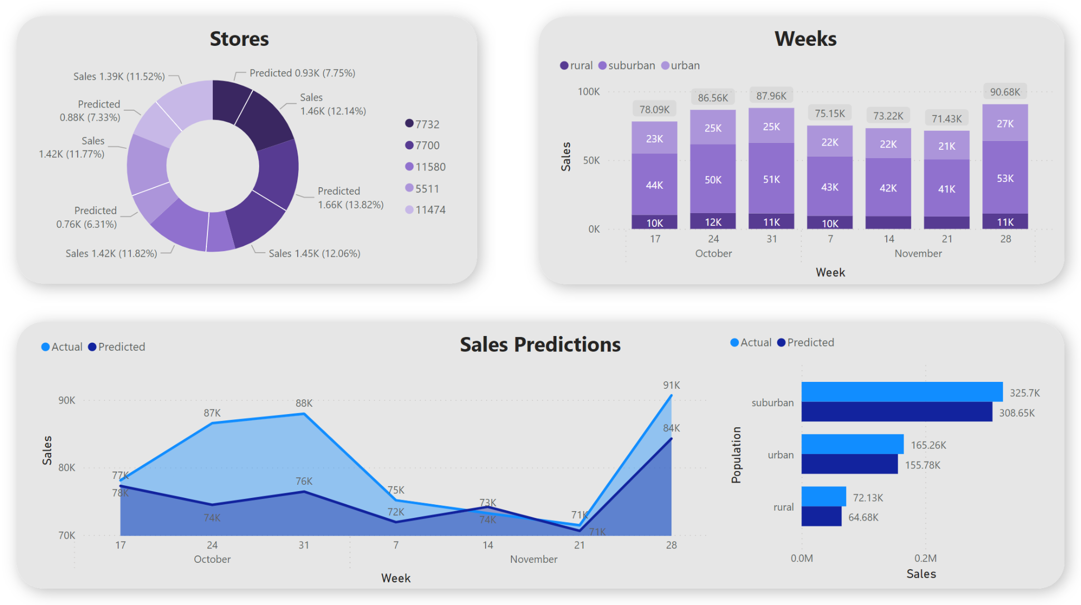
Notes:
We can see the information distributed in three sections when we take a look at the dashboard. In the first box above we can see a top 5 of stores with their the Actual sales in the donut chart. the color scale represents the sales podium
Next to it in the stacked column chart we can compare how the actual sales performed in the different population types each week. In the box below we can observe the information centered in comparing the actual sales vs the predicted ones in two different ways, first the area chart displays how the prediction went week after week. As a particular case here we can see the week of November 14 as the only one in which actual sales did not exceed predictions.
And second in the clustered bar chart the same comparison of sales vs predictions are shown grouped by the different population types.

Slide 4
Problem 2:
Use the provided datasets to create a table that shows actual sales versus impressions_count by store_id.
Sales vs Impressions
Notes:
In this problem I had to use the 3 tables of the model adding to the previous problem the "zip_codes" table that links stores and locations,
and the "impressions" table that contains the number of daily advertisements sent to the locations.

Slide 5
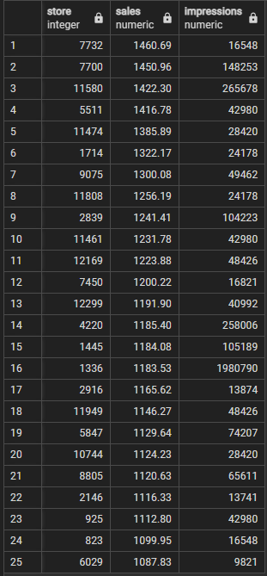
create table public.bk_p2 as select md.store_id as store, round(sum(md.actual)::numeric,2) as sales, sum(i.impressions) as impressions from public.model_data as md join ( select zc.store_id as store_id, sum(i.impression_count) as impressions from public.zip_codes as zc join public.impressions as i on zc.zip = i.zip_code group by zc.store_id order by impressions desc ) as i on md.store_id = i.store_id group by store order by sales desc
Notes:
To create this table I had to make a join between the "model_data" table where the sales information is and a sub-query that summarizes the impressions per store using the intermediary table "zip_codes".
I also added rounding of decimals to eliminate the unnecessary numbers.
Finally I added the "order by" clause to compare the information with the graphs in problem 1.

Slide 6
Problem 3:
Using the table you just created, summarize the actual sales versus the expected sales and impressions by population type.
Summarize
Notes:
This problem is similar to the previous one but the grouping in this case is done by population and the predictions are added to the comparison.

Slide 7
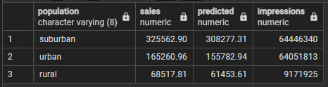
create table public.bk_p3 as select md.population_type as population, round(sum(md.actual)::numeric,2) as sales, round(sum(md.predicted)::numeric,2) as predicted, sum(i.impressions) as impressions from public.model_data as md join ( select zc.store_id as store_id, sum(i.impression_count) as impressions from public.zip_codes as zc join public.impressions as i on zc.zip = i.zip_code group by zc.store_id order by impressions desc ) as i on md.store_id = i.store_id group by population order by sales desc
Notes:
To create this table I did a join between the "model_data" table where the sales and the prediction information is and a sub-query that summarizes the impressions per store using the intermediary table "zip_codes".
I also added rounding of decimals to eliminate the unnecessary numbers.
Finally I added the "order by" clause to compare the information with the graphs in problem 1.

Slide 8
Problem 4:
Is there anything you found that might suggest our predictions are biased or flawed? If so, please explain why you believe this.
Analysis

Slide 9
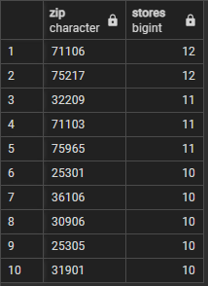
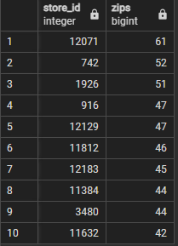
select zip, count (distinct store_id) as stores from public.zip_codes group by zip order by stores desc limit 10
select store_id, count (distinct zip) as zips from public.zip_codes group by store_id order by zips desc limit 10
Notes:
the fact that a store can have several zip codes assigned to it and that in turn a zipcode can have several stores in its region.
Generally one would think that the zipcode is an attribute of a store and that in some particular case there may be more than one store in the same region leading these stores to share the attribute.
The fact that a store can have several zipcodes leading this store to operate on several regions increases the complexity of the problem a little.
I could also add that the date handling is different between the "impressions" and "model_data" tables, this also increased the complexity a little.

Slide 10
Business Problem
Bath and Body Works is considering a change of its digital payment vendor

Slide 11
Bath and Body Works
Company
Context
Problem statement
BBW’s is a company that is dedicated to the beauty products business, it has its own eCommerce (bathandbodyworks.com) where it carry out its sales
5% of all traffic to the site make a purchase. Of those that purchase, 30% use a Visa card, 30% use a Mastercard, 20% use Amex card, 5% use a Discover card, the rest use PayPal.
A new vendor has approached BBW with a new offer removing the monthly fee BBW’s is currently paying, slightly increasing the average fee and taking out Amex payment method
Notes:
Bath and Body Works is considering a change of its digital payment vendor. BBW’s current payment vendor (Partner A) accepts all major credit cards, charges a variable processing fee per credit card type, and also receives a flat monthly fee for service. BBW also utilizes
PayPal to process online and mobile payments. PayPal has its own contract and will not be affected should the payment vendor change.
Currently, bathandbodyworks.com sees 5% of all traffic to the site make a purchase. Of those that purchase, 30% use a Visa card, 30% use a Mastercard, 20% use an American Express card, 5% use a Discover card, and the balance makes their purchase using PayPal. Partner A
charges fees of 2.25%, 2.25%, 3.2%, and 2.75% respectively. Due to the complexity of the PayPal contract, their rate is variable. The vendor also charges $500 per month.
A new vendor (Partner B) has approached BBW with the following offer: No monthly fee and a flat processing rate (2.75%) for Visa, Mastercard, and Discover card holders (they do not accept American Express). You’ve been placed in charge of the business decision.
Please explain your analysis of the above factors and make a recommendation on whether BBW should continue business with Partner A or enter into a new agreement with Partner B. Make all the assumptions you want as long as they are reasonably explained.

Slide 12
Fee Comparison
Methods | Partner A | Partner B
Visa card | 2.25% | 2.75%
Mastercard | 2.25% | 2.75%
American Express | 3.2% | Not accepted
Discovery card | 2.75% | 2.75%
Paypal* | 3% | 3%
Monthly fee | $500 | No fee
* We assume the average fee of using PayPal is 0,3%
Notes:
Here i make the first assumption putting a 3% as the paypal fee

Slide 13
Key Points
Then we need to highlight some key points from the business
Bathandbodyworks.com sees 5% of all traffic to site make a purchase
From the public that make a purchase:
30% use Visa card
30% use Mastercard
20% use American Express
15% use PayPal
5% use a Discover card
The switch of partner would mean losing American Express payment method
The switch of partner would also mean removing the $500 fee

Slide 14
First Scenario
Method | % of purchase | Sales* | Partner A fee | Partner A cost | Partner B fee | Partner B cost
Visa | 30% | $216,000 | 2.25% | $4,860 | 2.75% | $5,940
Mastercard | 30% | $216,000 | 2.25% | $4,860 | 2.75% | $5,940
American Express | 20% | $144,000 | 3.2% | $4,608 | - | -
Discovery | 5% | $36,000 | 2.75% | $990 | 2.75% | $990
PayPal* | 15% | $108,000 | 3% | $3,240 | 3% | $3,240
Monthly fee |  |  |  | $500 |  | $0
Total |  | $720,000 |  | $19,058 |  | $16,110
*assuming that the standar traffic of bathandbodyworks.com over a month is 1.2M visits and that the average purchase is $12 [5% of 12000000 * $12 = $720.000]
* We assume the avg fee of using PayPal is 0,3%
Notes:
After doing some research on websites that are dedicated to the sale of products similar to those sold by the client, the monthly traffic is approximately 1.2 million and the average purchase is $12 dollars.
Here we find ourselves with a problem: what to do with the portion of the market that uses American Express as a payment method?

Slide 15
Redistributed Scenario
Methods A | % of purchase A | Sales A* | Partner A fee | Partner A cost
Visa | 30% | $216,000 | 0.0225 | $4,860
Mastercard | 30% | $216,000 | 0.0225 | $4,860
American Express | 20% | $144,000 | 0.032 | $4,608
Discovery | 5% | $36,000 | 0.0275 | $990
PayPal* | 15% | $108,000 | 0.03 | $3,240
Monthly fee |  |  |  | $500
Total |  | $720,000 |  | $19,058
Being the cost of Partner A $19.058
2,65% of the $720.000 income
Methods B | % of purchase B | Sales B* | Partner B fee | Partner B cost
Visa | 35% | $252,000 | 0.0275 | $6,930
Mastercard | 35% | $252,000 | 0.0275 | $6,930
Discovery | 10% | $72,000 | 0.0275 | $1,980
PayPal* | 20% | $144,000 | 0.03 | $4,320
Monthly fee |  |  |  | 0
Total |  | $720,000 |  | $20,160
Being the cost of Partner B $20.160
2,8% of the $720.000 income
*assuming that the standar traffic of bathandbodyworks.com over a month is 1.2M visits and that the average purchase is $12 [5% of 12000000 * $12 = $720.000]
*we assume the avg fee of using PayPal is 0,3%
Notes:
The scenario with Partner A remains the same
To solve the problem, I assumed that this portion of the market will have another credit card or will use Paypal, so I equitably redistributed that 30% between the remaining methods for Partner B's scenario.
We can see that using these specific numbers it is not convenient to change partners since this would lead to paying a higher percentage of the monthly income
But what if we want to find the exact monthly income at which it would be better for us to change to parter B?

Slide 16
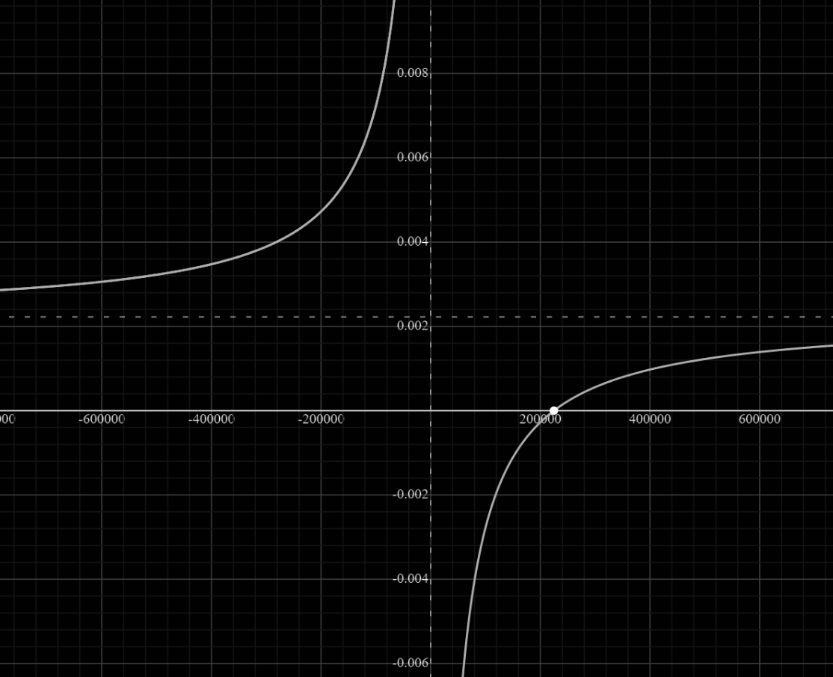



Finding the Breaking Point
Notes:
In the mathematical function seen above we observe the unknown x, which would be the income we want to find. We divide this income between the different percentages of the market occupied by the means of payment and their respective fees.
We also divide everything by the income itself to be able to match the result to the percentage that Partner B offers us, being this percentage 2.8%.
When we take out the common factor, divide both sides of the equality by partner B's percentage and multiply both sides by x we can find the monthly income we are looking for.
The higher the client's monthly income, the less worth it is to change partners.
but the closer we get to the breaking point, this being $224719 changing partners is more convenient
We can see that in the graph there is an asymptote but that is not important for this problem, what matters is when the function is equal to 0.028 on the Y axis.
since here we will find the monthly income that the client would have to have in order for the two partners to charge the same percentage.

Slide 17
Equalized Scenarios
Methods A | % of purchase A | Sales A | Partner A fee | Partner A cost
Visa | 30% | $67,415.7 | 0.0225 | $1,516.9
Mastercard | 30% | $67,415.7 | 0.0225 | $1,516.9
American Express | 20% | $44,943.8 | 0.032 | $1,438.2
Discovery | 5% | $11,235.9 | 0.0275 | $309.0
PayPal* | 15% | $33,707. | 0.03 | $1,011.2
Monthly fee |  |  |  | $500.0
Total |  | $224,719 |  | $6,292.1
Being the cost of both partners $6,292.1
2,8% of the $224,719 income
Methods B | % of purchase B | Sales B | Partner B fee | Partner B cost
Visa | 35% | $78,651.65 | 0.0275 | $2,162.9
Mastercard | 35% | $78,651.65 | 0.0275 | $2,162.9
Discovery | 10% | $22,471.9 | 0.0275 | $618.0
PayPal* | 20% | $44,943.8 | 0.03 | $1,348.3
Monthly fee |  |  |  | $0.0
Total |  | $224,719 |  | $6,292.1
*we assume the avg fee of using PayPal is 0,3%
Notes:
We return to the scenarios but this time using the monthly income that we found with the function and as we can see, both partners would be making the same monthly charge.

Slide 18
Conclusion
Being “Partner A” the only one who has a fixed constant monthly fee leads the decision to a breaking point, if the the traffic scenario on the eCommerce or the average purchase per user were different resulting in a monthly income of $224,719 the percentage of the total fee would be 2,8% for both partners.
In any case where the monthly income were below $224,719 it is recommended to change partner. If the monthly income is higher than the mentioned amount then the partner switch
is not recommended.
Notes:
Being “Partner A” the only one who has a fixed constant monthly fee leads the decision to a breaking point, if the the traffic scenario on the eCommerce or the average purchase per user were different resulting in a monthly income of $224,719 the percentage of the total fee would be 2,8% for both partners.
In any case where the monthly income were below $224,719 it is recommended to change partner.
If the monthly income is higher than the mentioned amount then the partner switch
is not recommended.

